Slide 1
Analog Project
Automatic Solar Tracker
Group 10
January 3, 2023

Slide 2
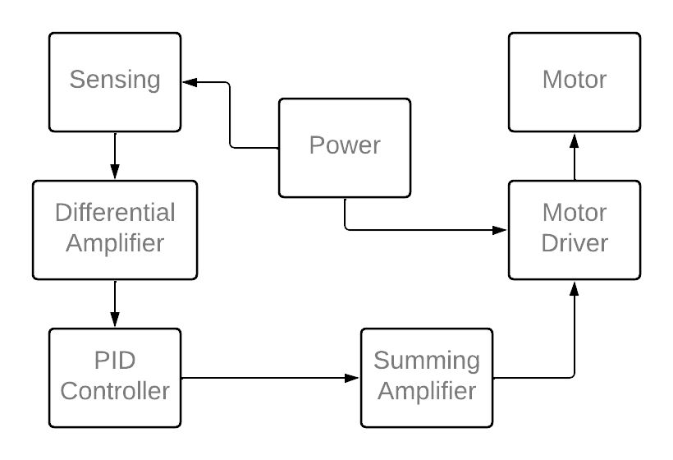
Block Diagram

Slide 3
Component Selection
Light Sensor: 12mm LDR
Dark Resistance: 1MΩ
Light Resistance: 5-10 KΩ
Alternatives: Phototransistor is an alternative light sensor.
In a phototransistor, the collector current is varying with light intensity. Since LDR gives a change in voltage with light intensity, LDR is selected. LDR is capable of providing sudden voltage changes with response time of 30ms which is quite enough to track the movement of sun.

Slide 4
Component Selection
2. OPAMP Selection
UA741CP
UA741CP is a general-purpose operational amplifier featuring offset-voltage null capability. The datasheet states that this opamp is ideal for summing amplifiers and integrators. Also, its other specifications such as slew rate of 0.5µV/s, SVRR of 90 dB are enough for our applications.
TL072CP
TL072CP is a dual operational amplifier with fast slew rate of 13µV/s and reduced noise which are used for high accuracy applications. These have a higher input resistance of 10¹²  compared to UA741CP.

Slide 5
Component Selection
3. Power Supply
We are planning to operate OPAMPs with single power source of 12V. In the final product, we are hoping to use a 12V lead acid accumulator since we need to power the solar tracker throughout the day-time.

Slide 6
Component Selection
4. Motor
We are planning to use a DC Gear motor for our automatic solar tracker. For that we hope to use L298D dual H bridge motor driver with PWM control signals.

Slide 7
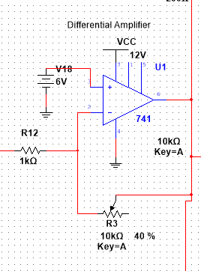
Differential Amplifier
Here the differential voltage between the input
voltage and set point voltage(6V) is being amplified.

Slide 8
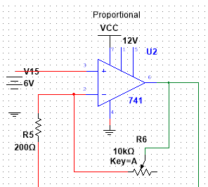
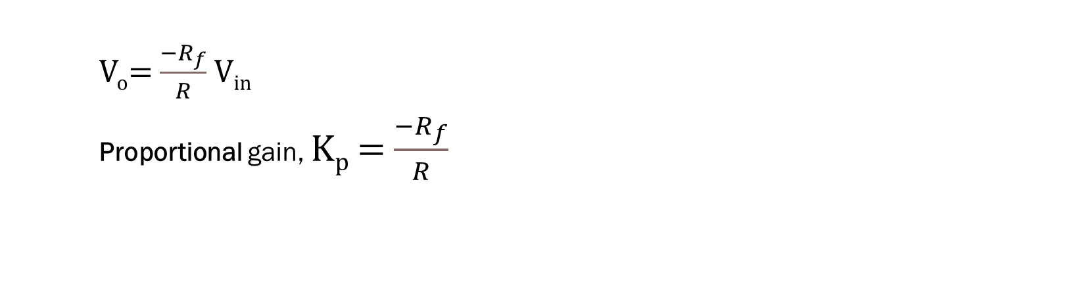
PID Controller
V_{o}= $\frac{−R_{f}}{R}$ V_{in}
Proportional gain, K_{p} = $\frac{−R_{f}}{R}$

Slide 9
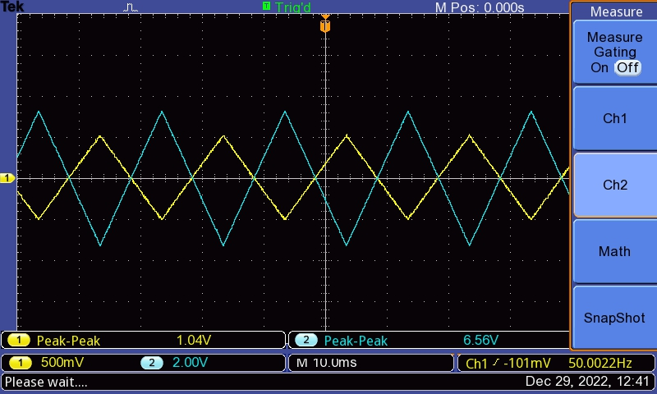
Output of proportional controller

Slide 10
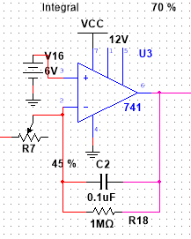
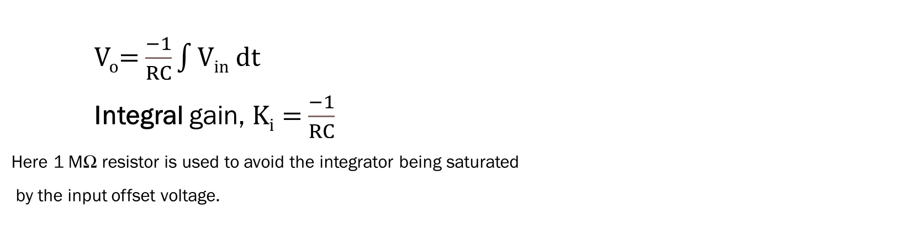
PID Controller
V_{o}= $\frac{−1}{RC}\int{Vin dt}$
Integral gain, K_{i} = $\frac{−1}{RC}$
Here 1 MΩ resistor is used to avoid the integrator being saturated
by the input offset voltage.

Slide 11
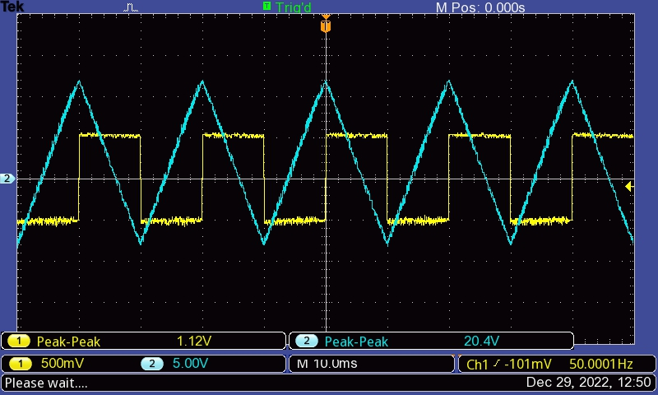
Output of integral controller

Slide 12
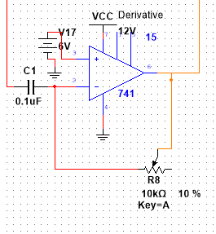
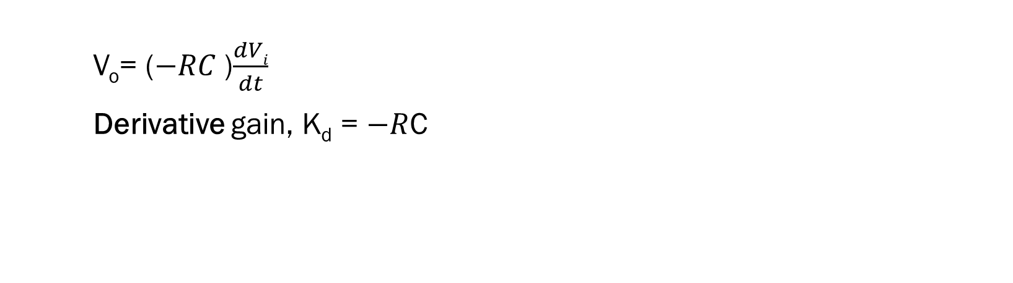
PID Controller
V_{o}= ($−RC$)$\frac{dVi}{dt}$
Derivative gain, K_{d} = $−R$C

Slide 13
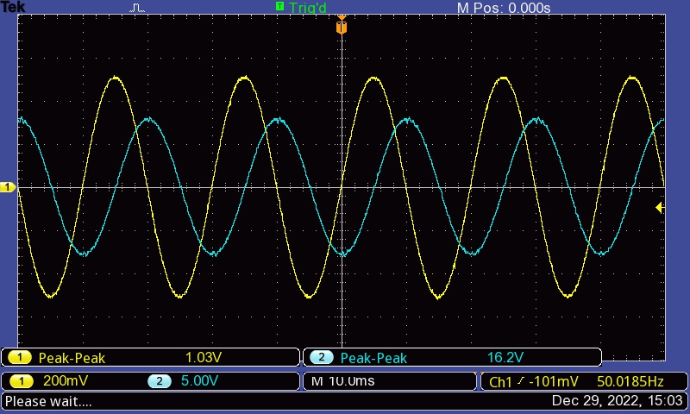
Output of derivative controller

Slide 14
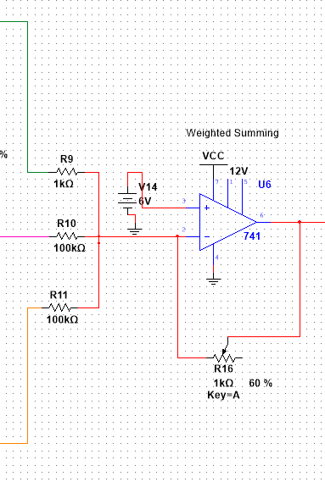
Weighted Summing Amplifier
P,I,D controller outputs are weighted and summed by this.
Here, larger resistors are used for I and d controllers as
their effect needs to be reduced appropriately for the smooth
operation of PID controller.

Slide 15
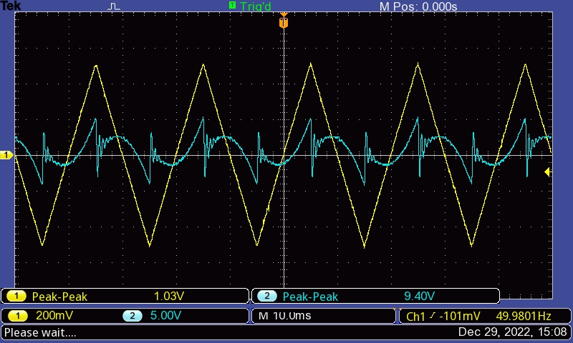
Output of summing amplifier

Slide 16
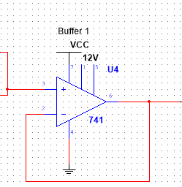
Voltage Buffers
Voltage buffers are used in our circuit to isolate the input
stage from output stage. We have used a OpAmp with higher
Input impedance. (TL072CP - These have a higher
input resistance of 10¹²  compared to UA741CP).

Slide 17
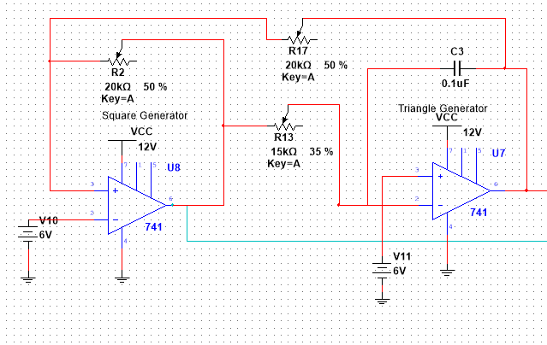
Triangular Wave Generation
The triangular wave form between 0-12V with 500Hz frequency is generated using the Schmitt trigger and integrator.
Here frequency of the waveform is adjusted by varying R₁₃.
The threshold voltage is adjusted keeping R₂/R₁₇ nearly equal to unity so that nearly 0-12V amplitude variation is possible.

Slide 18
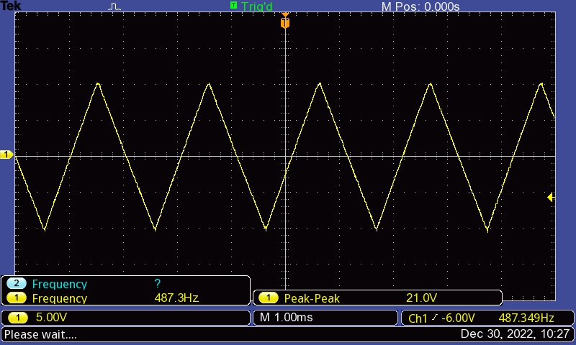
Output of triangle wave generator

Slide 19
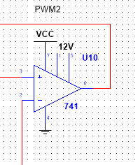
PWM Generation
PWM waves corresponding to the control signal from PID controller is created by the comparator with triangular waveform.

Slide 20
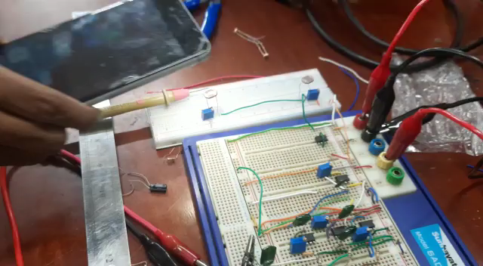
PWM

Slide 21
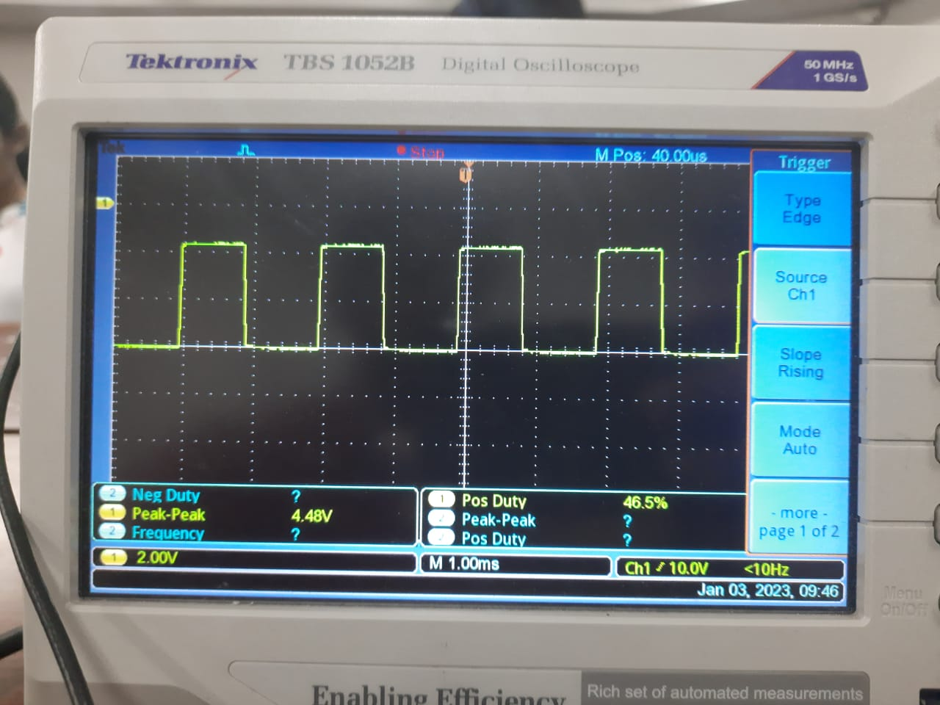
5V peak- peak PWM for motor drive

Slide 22
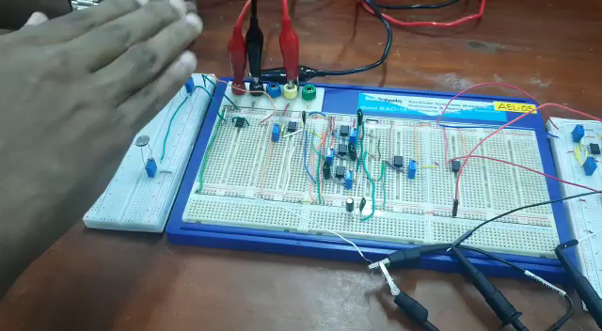
Motor in action

Slide 23
THANK YOU

